Slide 1
Housing Price Prediction Capstone
Sharon Li

Slide 2
CONTENT
Introduction
Data Description
Correlation Analysis
Models & Conclusion

Slide 3
Introduction
The data set is from kaggle: https://www.kaggle.com/datasets/greenwing1985/housepricing, which contains over 500 thousand data with 15 features, containing variables below:
▲ Area
▲ Facilities
▲ Location
▲ Material for floors
▲ Energy
▲ Miscellaneous

Slide 4
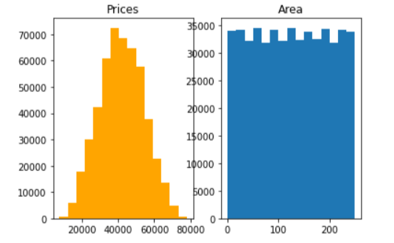
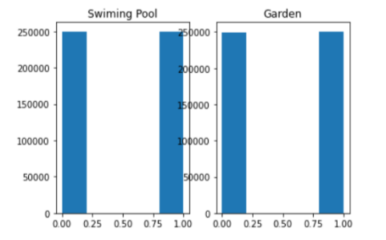
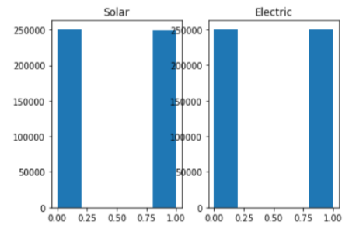
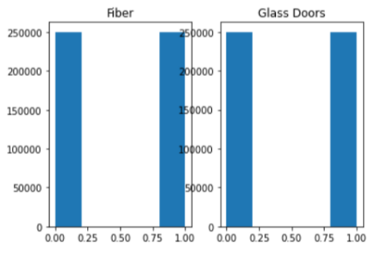
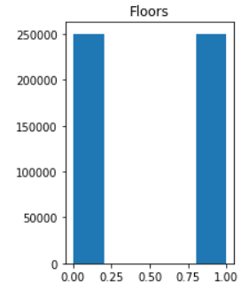
Data Description
normal distribution:
prices of the houses
Averagely distributed:
area of houses
multiple floors or not
with swimming pool or not
With garden or not
With solar or not
With electric or not
With fiber or not
with glass doors or not

Slide 5
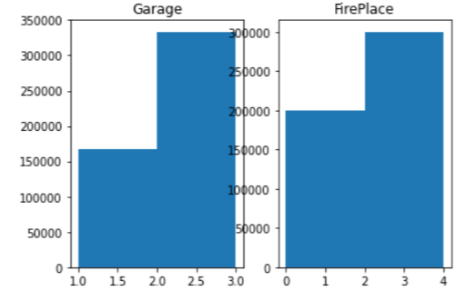
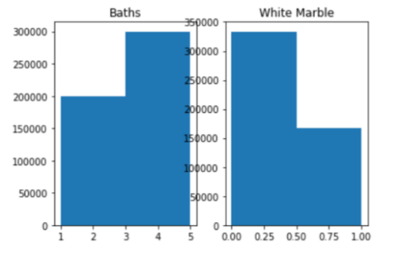
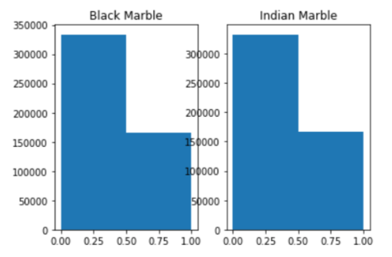
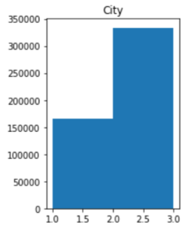
Data Description
right skewness:
number of garage
number of fireplace
number of baths
which city is the house located in
left skewness:
use white marble or not
use black marble or not
use indian marble or not

Slide 6
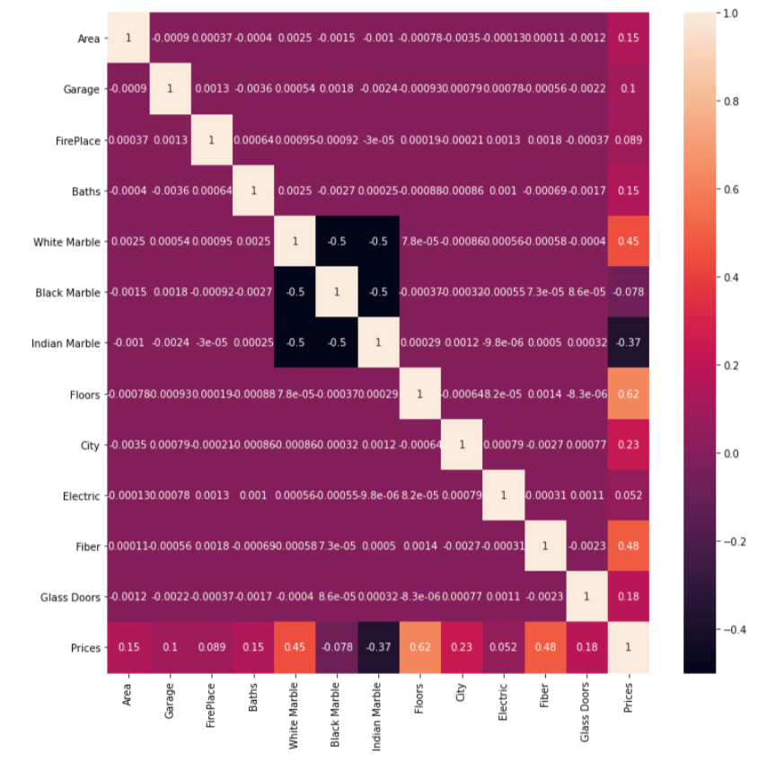
Correlation Analysis
Variables with less correlation:
Fireplace
Black Marble
Electric

Slide 7
Model & Conclustion
 | Linear Regression | Lasso | Ridge | ENet | Random Forest | Decision Tree
R square for train set | 0.98952 | 0.989516 | 0.989516 | -0.0169 | 0.98516 | 0.98263
R square for test set | 0.98953 | 0.989525 | 0.989529 | -0.02127
Ridge from Linear Regression has the best performance.
Notes:
OK， next I will introduce about our findings on customer profile. The dataset recorded customers information into 5 parts: gender, age, occupation, city, and marital status.
First, in terms of gender, it shows an unexpected result compared with general intuition. Data shows that the males account the main part of customers on Black Friday. Also, the males won in terms of average consumption. A big surprise, right?

Slide 8
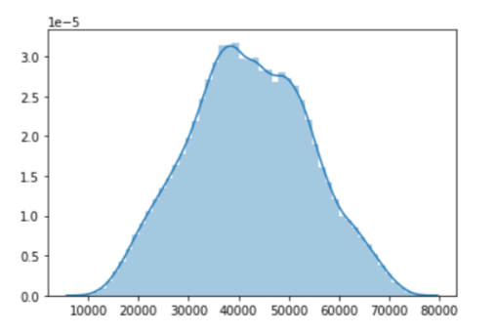
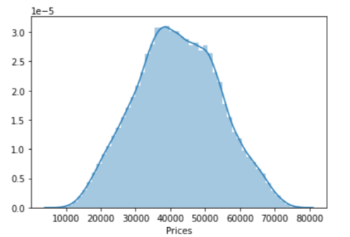
Model & Conclustion
Highest R-square shows the least error of prediction
Best models:
Ridge from Linear regression
alpha=0.001
fit with scaled training set
above: distribution plot for prediction
below: distribution plot for test set

Slide 9
THANK YOU
FOR WATCHING

